Slide 1
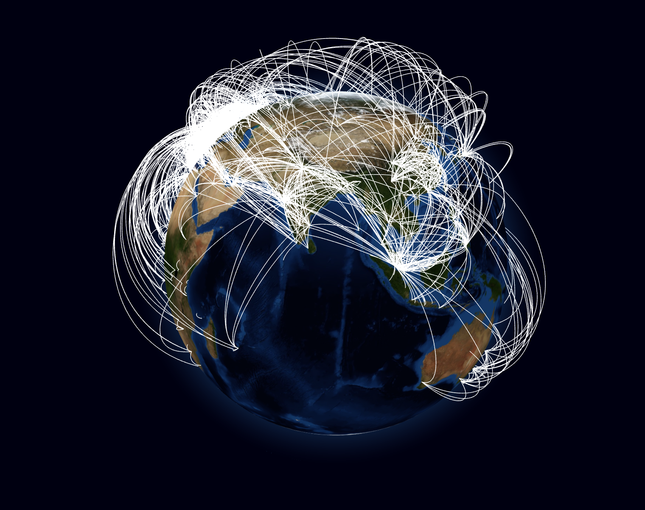
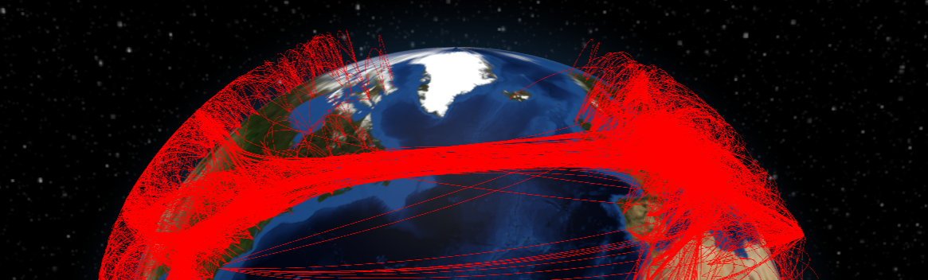
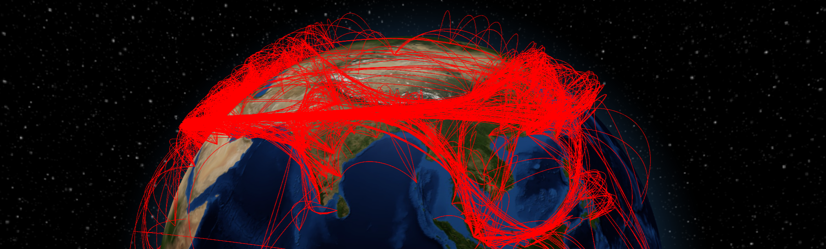
VU Visualisierung 2 (186.833) Edge-Path Bundling
Teaser image of your planned work
David Köppl 12022493, Elias Füricht 52005515
Institute of Visual Computing & Human-Centered Technology, TU Wien, Austria

Slide 2
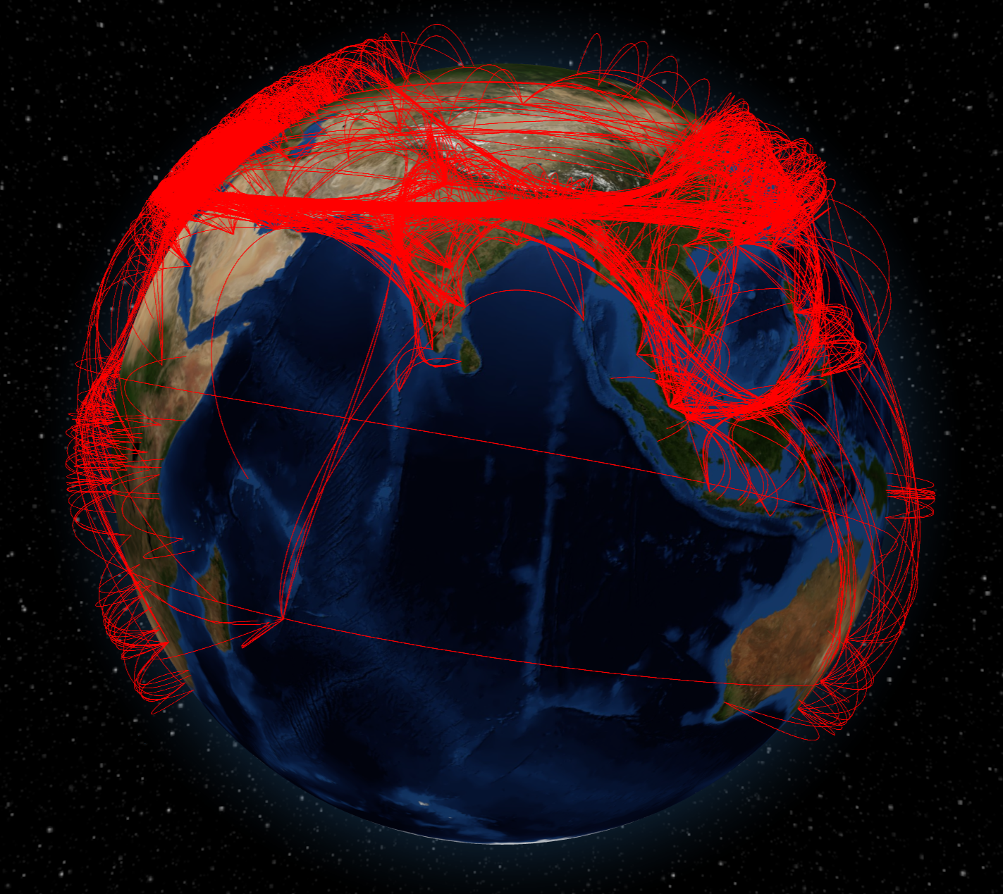
What did we do again?
Edge-Path Bundling: technique for reducing visual clutter in graphs.
Key Improvement: Avoids ambiguities by only bundling edges with real paths in the graph.
Notes:
Summarize the algorithms and concepts described in the paper.
If space is available, put some representative image here
~ 1 minute

Slide 3
Our Implementation
Merge datasets from Kaggle.com and openflights.org
Preprocess the data to filter out redundant connections
Construct graph from cleaned .csv files that hold flight information
Run edge-path bundling algorithm to extract control points
Generate Bezier curves based on extracted control points
Translate segments into atmosphere according to position on curve
Draw final line-segments
David Köppl, Elias Füricht
Notes:
Mapping on sphere will be tricky – challenges with shortest from e.g. Hawaii to Australia (2D Map vs Earth)

Slide 4

Let’s see it!

Slide 5
Wallinger et al. 2022
Markus Wallinger, Daniel Archambault, David Auber, Martin Nöllenburg, Jaakko Peltonen
Edge-Path Bundling: A Less Ambiguous Edge Bundling Approach
IEEE Transactions on Visualization & Computer Graphics, vol. 28, no. 01, pp. 313-323
2022

